Slide 1
Smart Grids
SGAM Mapping
templates
Paula González Font de Rubinat

Slide 2
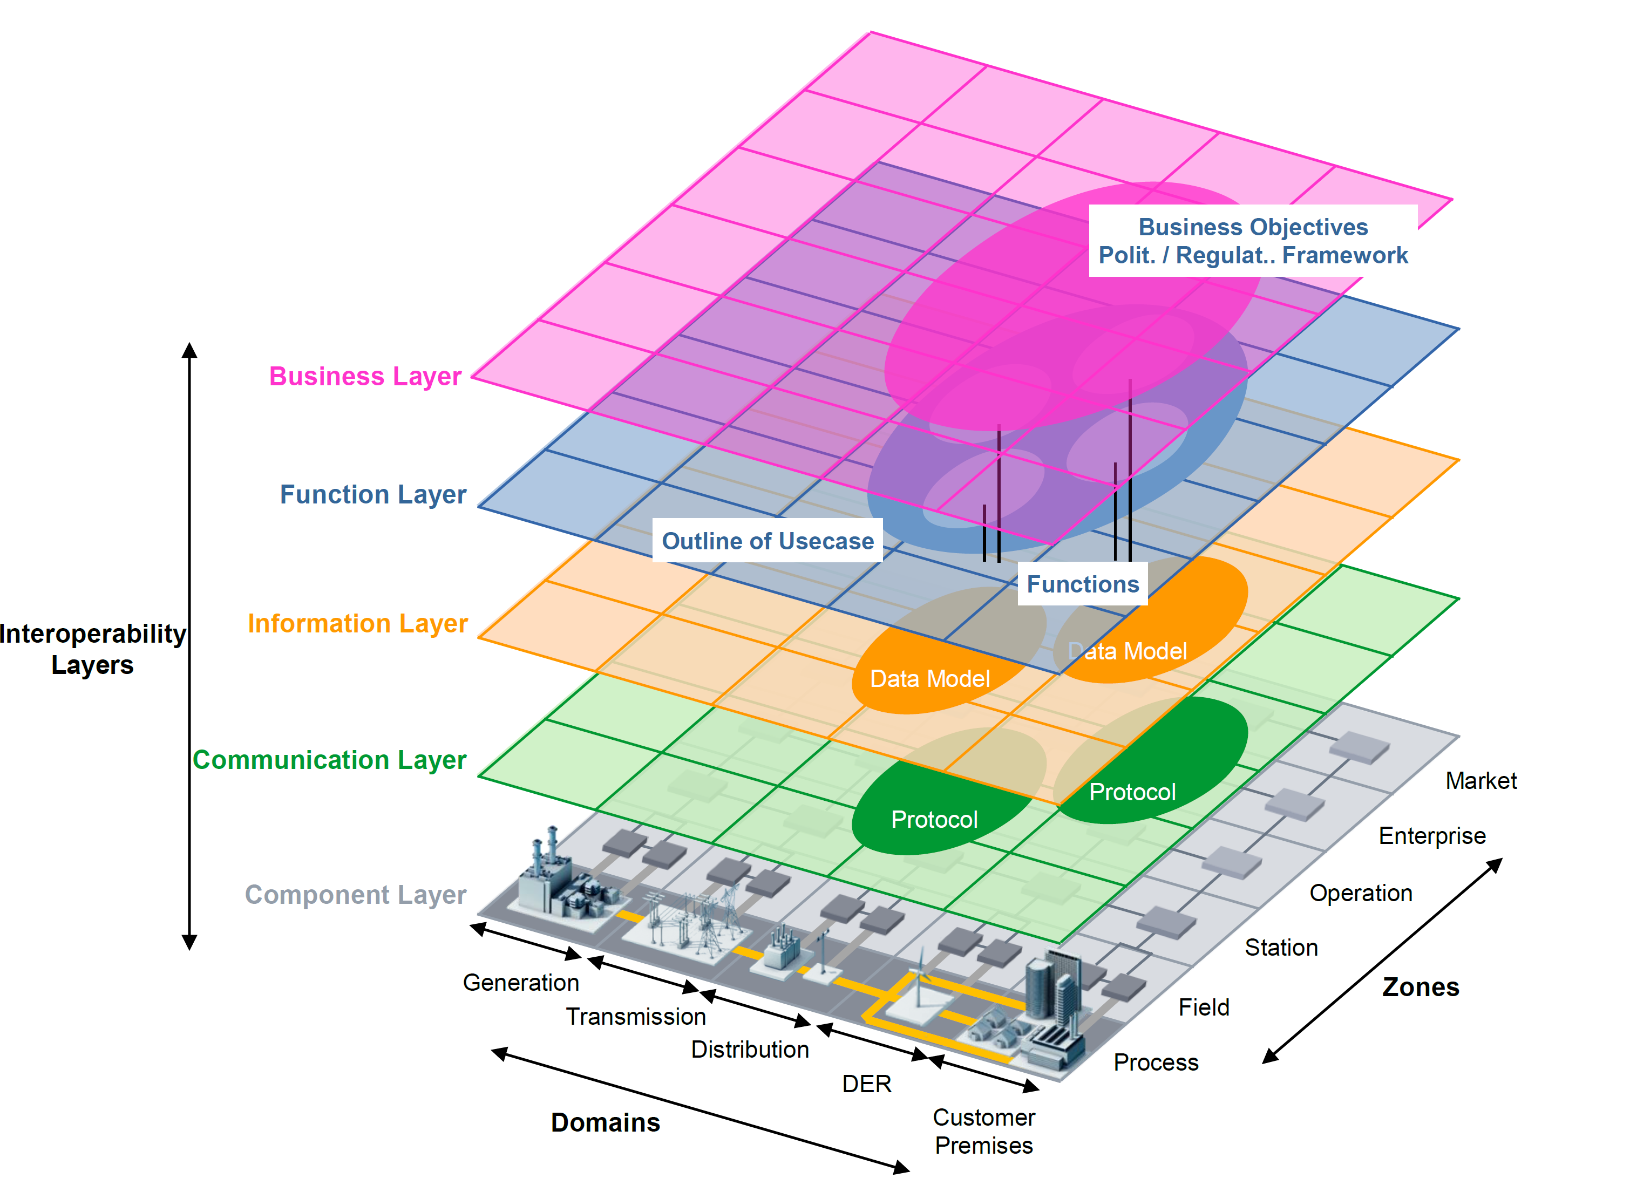
SGAM Framework
Source: Smart Grid Reference Architecture, CEN-CENELEC-ETSI Smart Grid Coordination Group

Slide 3
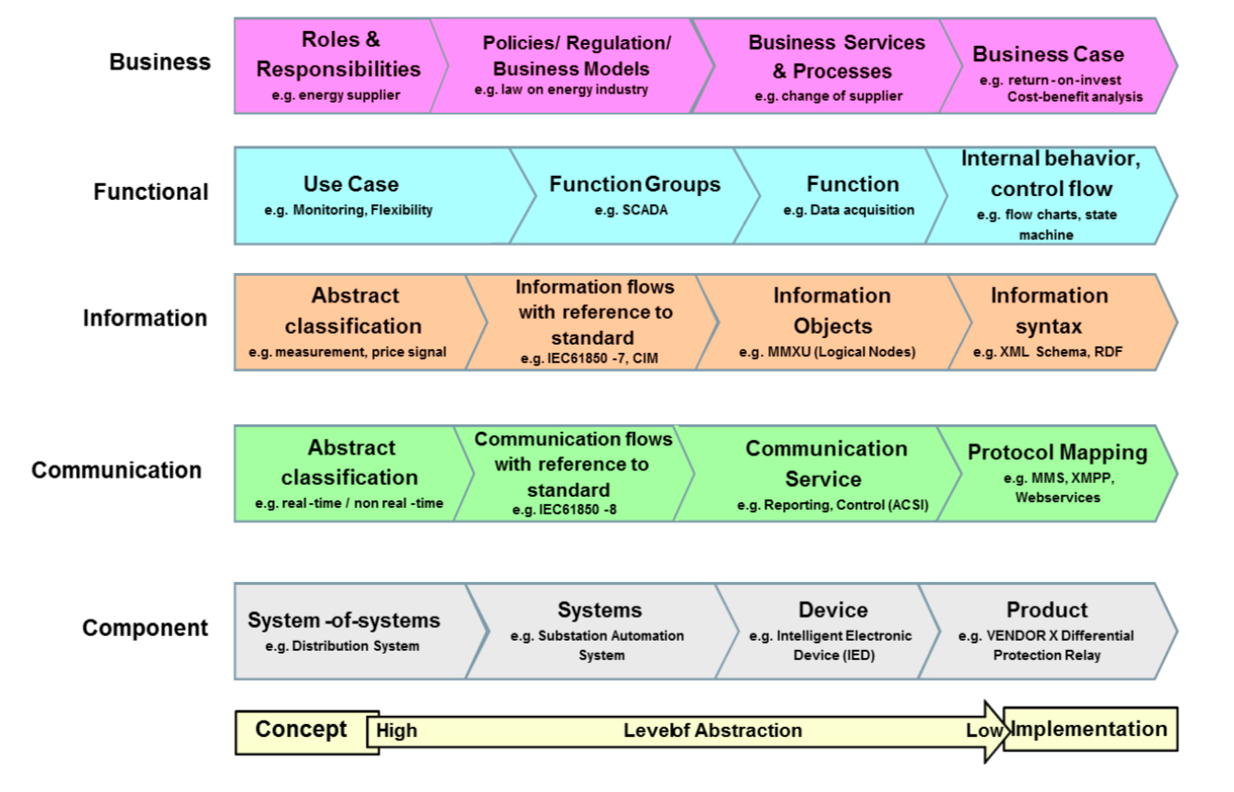
Layers abstraction level
SGAM User Manual - Applying, testing & refining the Smart Grid Architecture Model (SGAM)

Slide 4
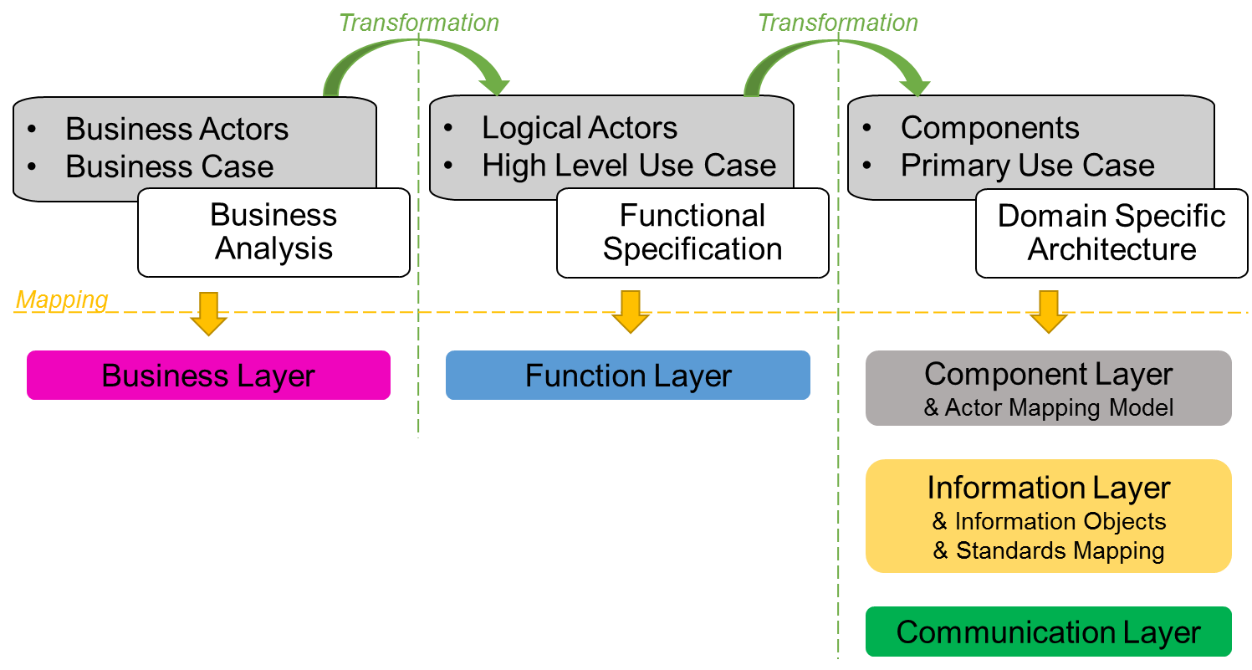
SGAM Methodology
Source: D1.3 Interoperability and Integration Analysis and Requirements - Resolvd

Slide 5
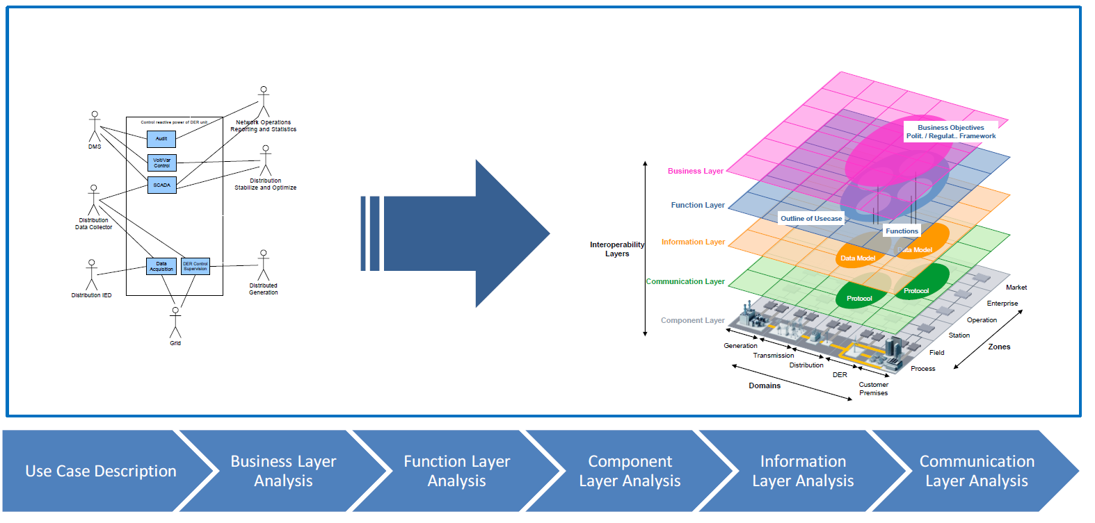
Use case mapping process to SGAM
Use Case
SGAM
Source: SGAM User Manual - Applying, testing & refining the Smart Grid Architecture Model (SGAM)

Slide 6
Use case template
Name
Objective
Actors
Relation to other use cases
Viewpoint and type
Description

Slide 7
Business layer

Slide 8
Business layer
BUC 1:

Slide 9
Function layer

Slide 10
Function layer

Slide 11
Components layer

Slide 12
Components layer

Slide 13
Smart Grids
Paula González Font de Rubinat

